Slide 1
URI pattern
Hafliði Sigtryggur Magnússon, National Land Survey of Iceland

Slide 2
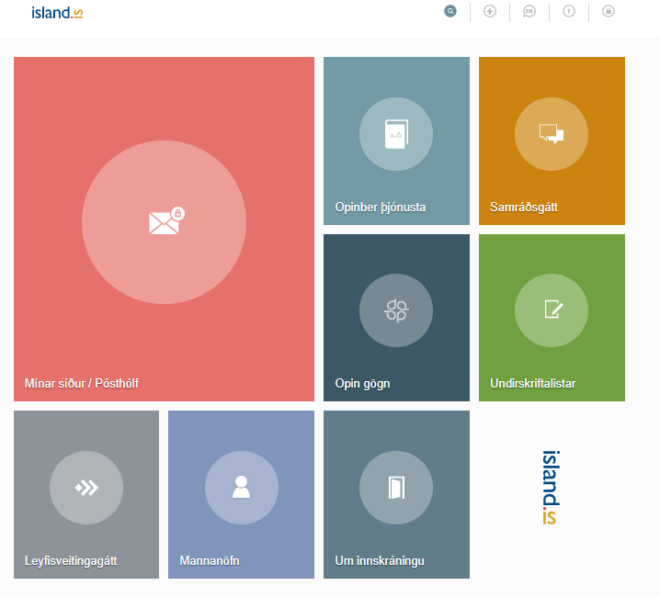
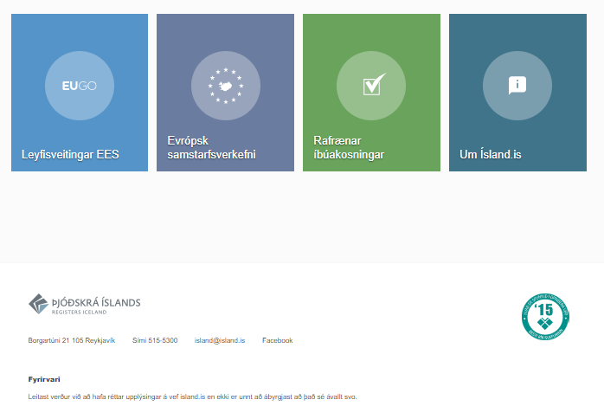
Current situation
No formal URI or URL pattern in use in Iceland, just “standard” links
To seek information or service we have a starting point
https://www.island.is/

Slide 3
Current situation
Technical Architecture for Public Service
Version 1.0 scheduled to be published in the end of 2019
Standardise and ease communication between government departments
Standardise and ease public access to Government and public data
X-Road
https://en.wikipedia.org/wiki/X-Road
“centrally governed distributed integration layer between information systems”
First iteration developed and launched by Estonia’s Information System Authority (RIA) in 2001
X-Road is a Data Exchange Layer (DXL) “solution that enables organizations to exchange information over the Internet.”

Slide 4
Technical Architecture for Public Service
Design access to data, either API or web services
May or may not “hide” the data provider
Standardised protocols
Open source not vendor locking
Learn from https://joinup.ec.europa.eu/
Joinup is a collaborative platform created by the European Commission and funded by the European Union via the Interoperability solutions for public administrations, businesses and citizens (ISA2) Programme. It offers several services that aim to help e-Government professionals share their experience with each other. We also hope to support them to find, choose, re-use, develop and implement interoperability solutions.

Slide 5
Takk fyrir

