Slide 1
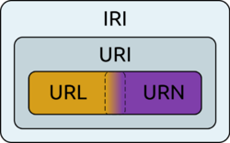
Nordic INSPIRE group-
NORDIC URI WEBINAR
Facilitator : Morten Borrebæk
Foto kilde: wikipedia

Slide 4
The intention of this webinar is to focus on the use of URI’s and the URI pattern in the Nordic country. The presentations will be given in English.
Agenda
Short introduction 10 minutes (Morten Borrebaek)
Presentation from Denmark 20 minutes (Lars Storgaard)
Presentation from Finland 20 minutes (Kai Koistinen)
Presentation from Iceland 20 minutes (Hafliði Sigtryggur Magnússon)
Presentation from Norway 20 minutes (Lars Inge Arnevik)
Presentation from Sweden 20 minutes (Michael Östling)
Closing session 10 minutes (Morten Borrebaek)

